Slide 1
Genome Informatics at Iowa State University
Transforming raw data into informative data for researchers
Andrew Severin
Genome Informatics Facility
Iowa State University
206 Science I
Iowa State University

Slide 2
What do I do?
Enable researchers to interpret high-throughput data
Encourage/Contribute to bioinformatics friendly infrastructure
Explore the latest open source software
Develop pipelines for efficient analysis
Contribute to papers and grants (LOS)
Train and Teach Bioinformatics
Write Grants
Meet the needs and communicate well with a diverse faculty to help facilitate NGS research on campus.
http://gif.biotech.iastate.edu
GIF@iastate.edu

Slide 3
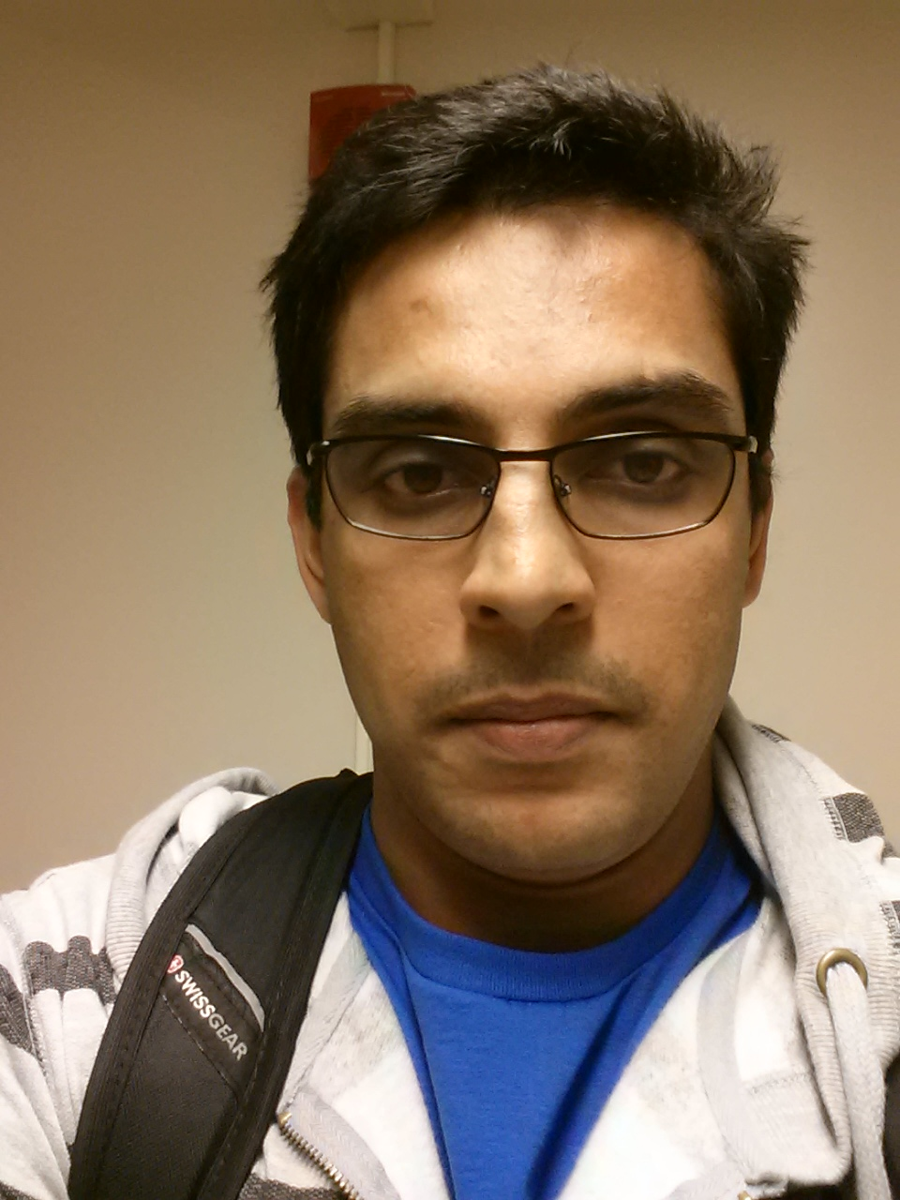
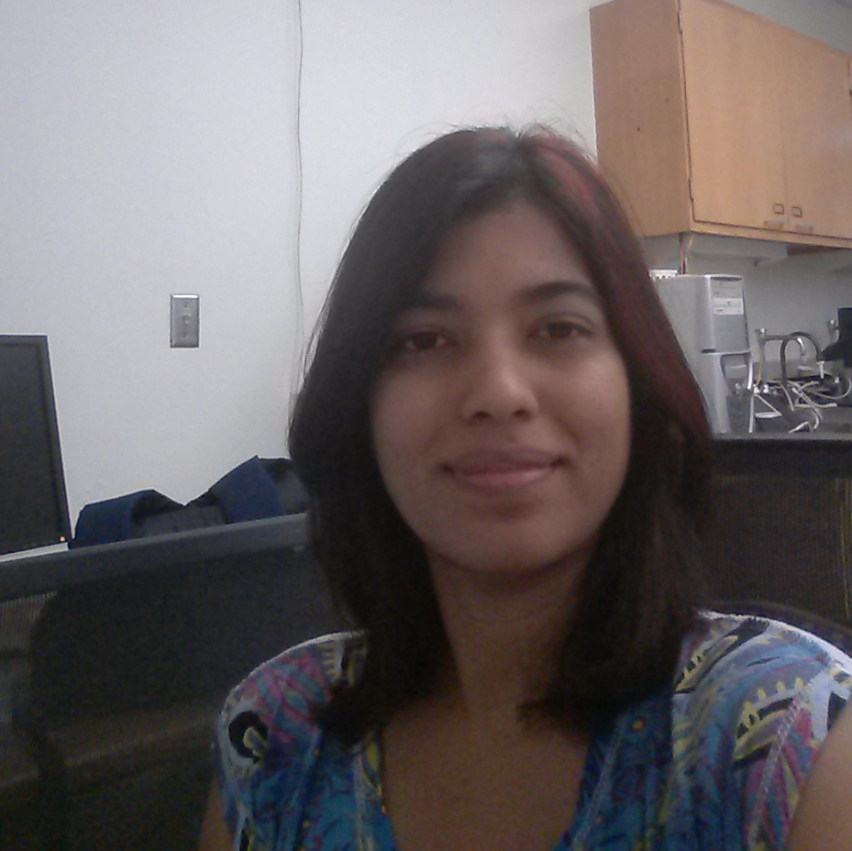

GIF Team
Arun Seetharam
Usha Muppirala
Margie Carter
Notes:
On the point ..
Main issue is I need more staff
Assistant Scientist IV is a new category that could help with hiring options but reduces retention incentives.

Slide 4
Projects
Genome Assembly and Annotation
Teosinte, Seriola lalandi
Pig Feces MetaGenome
RNA-Seq
(Seriola, nematode, potato)
(pigs, zebrafish, bacteria, maize)
Re-sequencing
(Soybean, P. sojae)

Slide 5
Class Objectives:
Think like a bioinformatician
Informatics are tools to understand BIOLOGY!
Biology, Sequencing Technology, Programs

Slide 6
Central Dogma of Bioinformatics
Understand the limitations and assumptions of the
Biological System
Sequencing Technology
Open Source Software

Slide 7
Class Topics:
Introduction
Alignment
Transcriptome assembly
Genome assembly
RNA-Seq Analysis
Pathway Analysis
SNP Calling

Slide 8
Expectations:
Attendance
Participation
Ask questions
Keep a notebook on the wiki
I want to see how you think
Do more than the bare minimum.

Slide 9
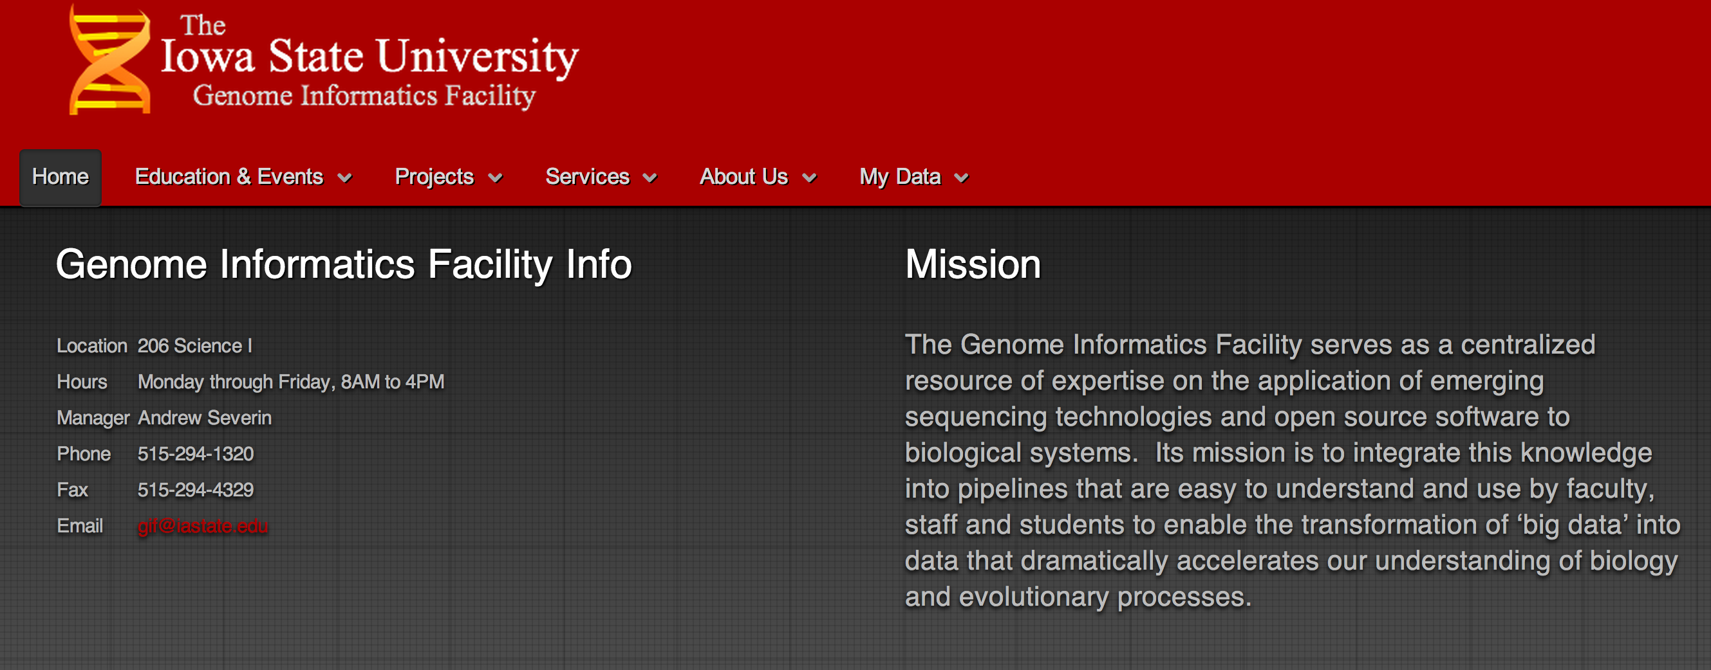
GIF http://gif.biotech.iastate.edu

Slide 10
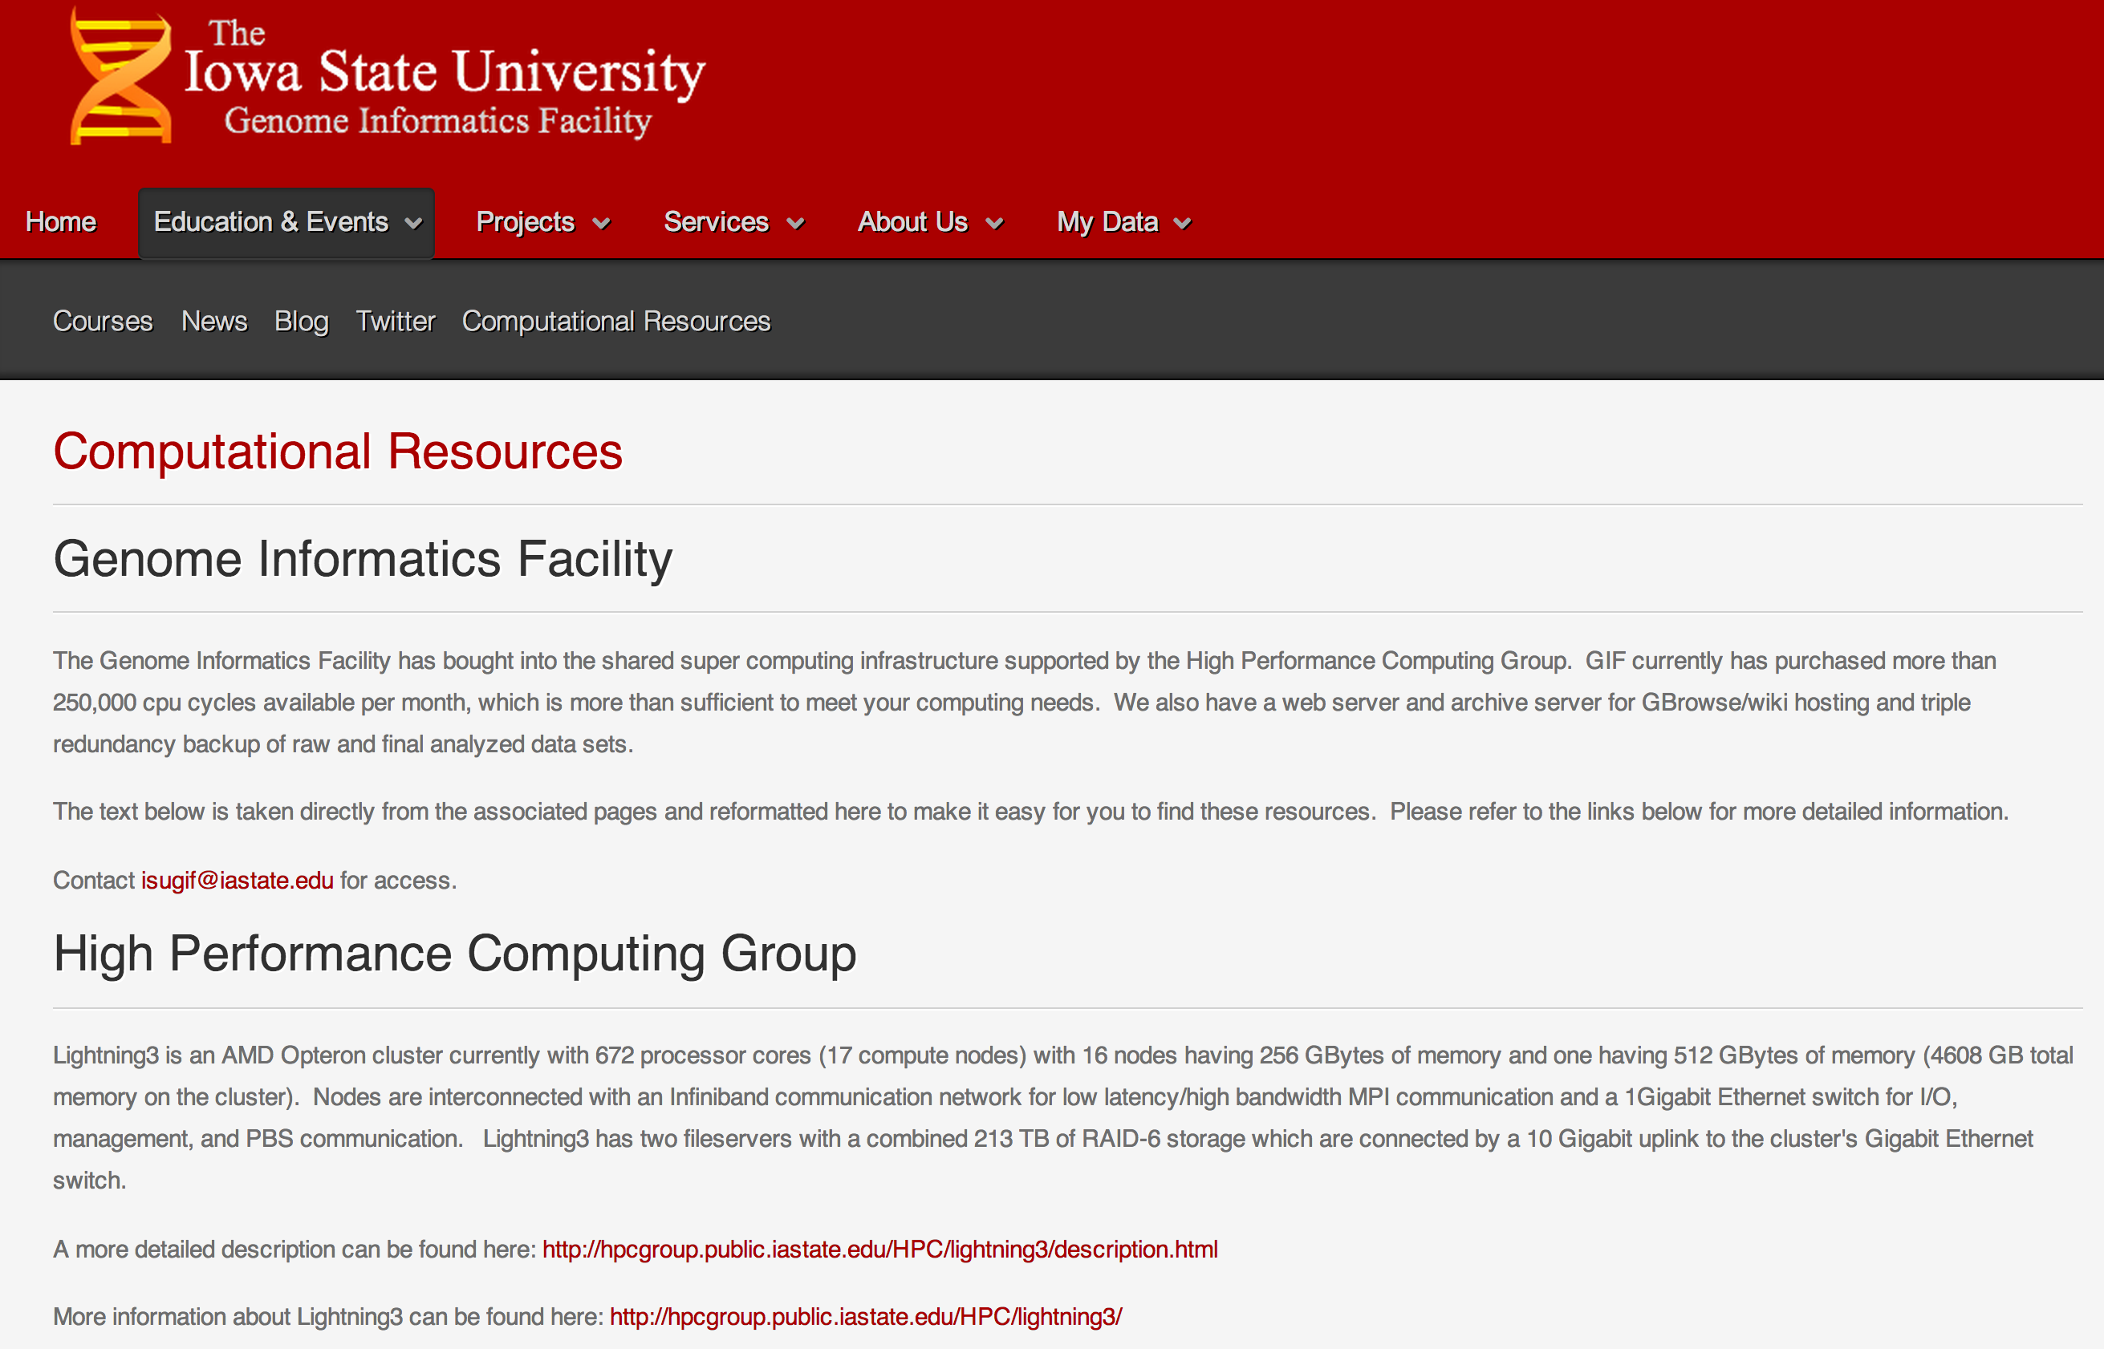
Computing Resources on Campus

Slide 11
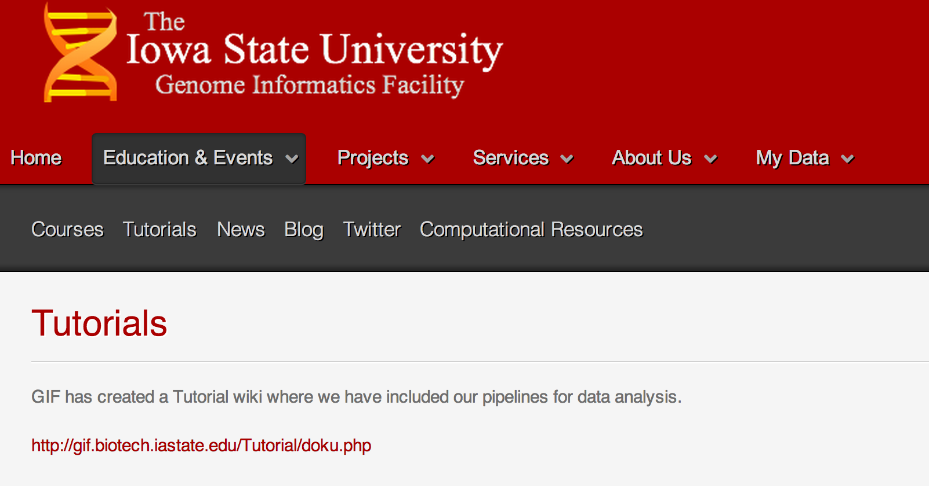
Tutorial Wiki

Slide 12
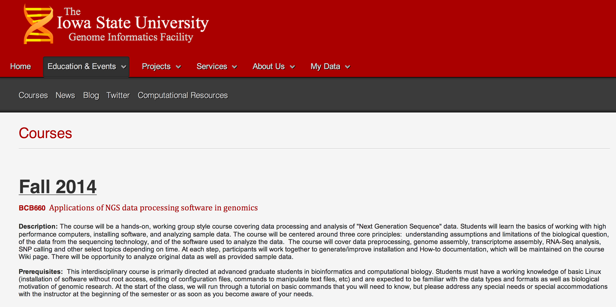
Class Wiki

Slide 13
Wiki and exercises
Log into the class wiki
http://gif.biotech.iastate.edu/Classes/

Slide 14
Accessing Super Computing Resources
Logging into hpc-class (remote machine)
ssh
Transferring and Downloading data
Git,wget,rsync,scp
Preinstalled software
Understanding Queues
Qstat, qtop
Submitting Jobs

Slide 15
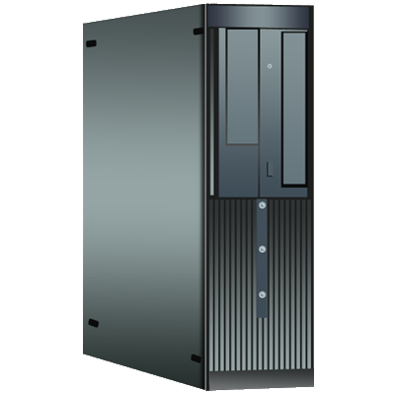
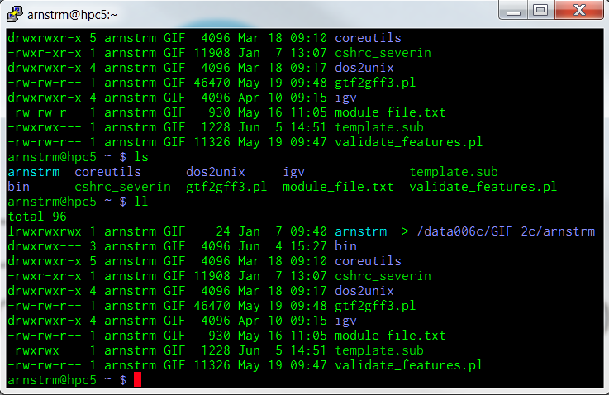

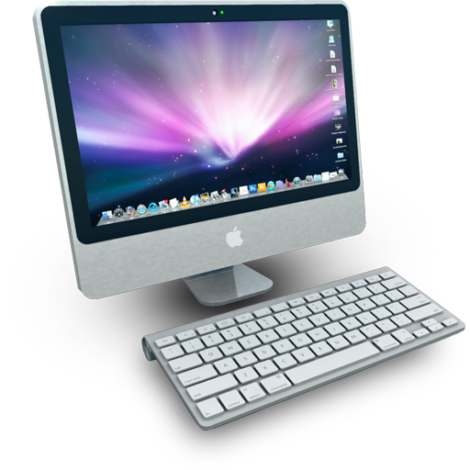
High Performance Computing (HPC)
HPC-class (education)
48 compute nodes
16 processors/node (768 total)
64Gb RAM/node (3.0Tb total)
Lightning3 (research)
17 compute nodes
32 processors/node (384 total)
256Gb RAM/node (3.2Tb total)
Compute Nodes
Condo (up coming)
316 compute nodes
8 processors/node (2528 total)
8Gb RAM/node (3.5Tb total)
Head Node
Terminal
SSH
Notes:
Can throw almost anything at it.
Lightning3 is a shared resource that researchers have been buying into it.
Condo will be an order of magnitude more nodes.

Slide 16
Logging in
Microsoft Windows:
PuTTY is an extremely small download of a free, full-featured SSH client.
SSH Secure Shell Client, also a full featured client that is commercial. It is available as part of the Iowa State University site-licensed software.

Slide 17
Logging in
Macintosh
ssh -X username@hpc-class.its.iastate.edu
Note: You will not see your password as you type.

Slide 18
Logging in
ls nothing in your folder
ls -la
pwd /home/netid
who Who else is on this machine
cp -r /home/severin/Basic_UNIX .
cd Basic_UNIX/WORKSHOP_FILES
The remote machine will have a prompt that looks like
[netid@hpc-class WORKSHOP_FILES]$

Slide 19
Transferring and downloading files
Downloading from a website
wget http://goo.gl/CDXx15 =soybean annotation
How do we look at this file?

Slide 20
Transferring and downloading files
Transferring files from our local machine to the remote machine
Open up a new terminal
touch cats.txt
scp cats.txt netid@hpc-class.its.iastate.edu:/home/netid
rsync -avz -e ssh cats.txt netid@hpc-class.its.iastate.edu:/home/netid

Slide 21
Pre-installed software
module use /shared/bioinformatics/modules
module avail
module what-is
fastqc --version
module load fastqc
fastqc --version

Slide 22
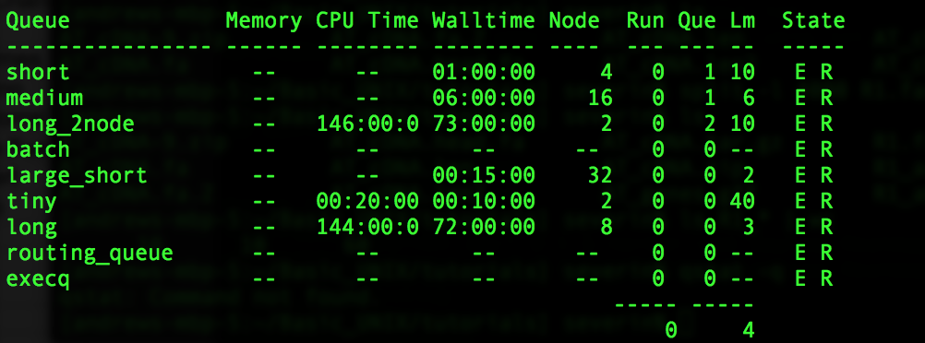
Understanding Torque and Queueing
qstat -q

Slide 23
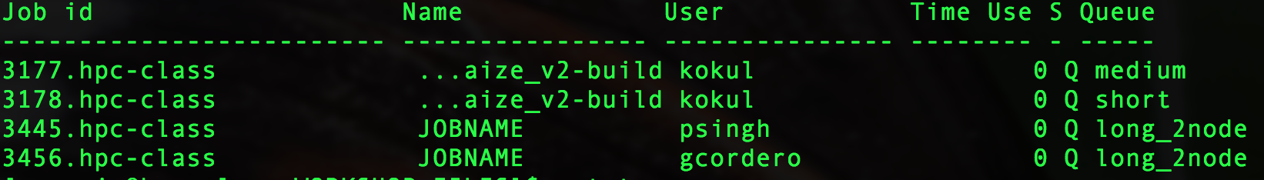
Understanding Torque and Queueing
qstat -a

Slide 24
Submitting a job
#!/bin/bash
#PBS -l vmem=16Gb,pmem=4Gb,mem=16Gb
#PBS -l nodes=1:ppn=4:compute
#PBS -l walltime=48:00:00
#PBS -N FASTQC ← You can change this
#PBS -o ${PBS_JOBNAME}.o${PBS_JOBID} -e ${PBS_JOBNAME}.e${PBS_JOBID}
cd $PBS_O_WORKDIR
fastqc R1.fastq ← Your command here

Slide 25
Submitting a job
/home/netid/Basic_UNIX/WORKSHOP_FILES
more jobfile.sub
qsub jobfile.sub
qstat –a
R1_fastqc.html
R2_fastqc.html
firefox R1_fastqc.html ← to view the results

Slide 26
Summary:
Logging into hpc-class (remote machine)
ssh
Transferring and Downloading data
git,wget,rsync,scp
Understanding Queues
Qstat, qtop
Submitting Jobs

Slide 27
Commands you should know
Navigation cd, ls, pwd
File creation touch,nano,mkdir,cp,mv,rm,rmdir
Reading more,less,head,tail,cat
Compression zip,gzip,bzip2,tar,compress
Uncompression unzip,gunzip,bunzip2,uncompress
Permissions chmod
Help man

Slide 28
More commands you should know:
Moving data cat,>,>>,<,|
Regular expressions /^.*[0-9]+[a-z]*.*$/
Find and replace grep,sed,tr
Manipulating rows/columns cut,awk
Comparing files wc,sort,uniq,diff,comm
Manipulating files split,join,paste

Slide 29
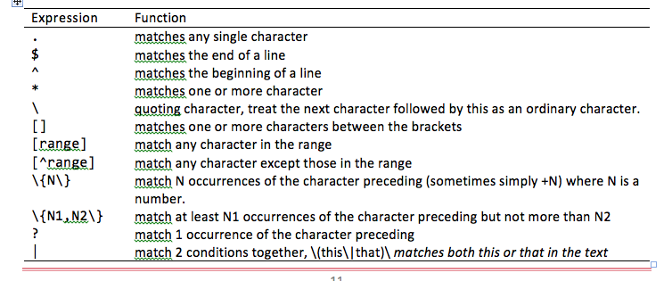
Regular Expressions (look this up)
Notes:
----- Meeting Notes (6/26/14 10:46) -----
For more complicated patterns we use Regular Expressions

Slide 30
AWK
BEGIN
 | FS |  |  |  | RS
NR
1 | Field 1 | Field 2 | Field 3 | Field 4 | Field 5
2 | Entry 1A | Entry 2A | Entry 3A | Entry 4A | Entry 5A
3 | Entry 1B | Entry 2B | Entry 3B | Entry 4B | Entry 5B
4 | Entry 1C | Entry 2C | Entry 3C | Entry 4C | Entry 5C
5 | Entry 1D | Entry 2D | Entry 3D | Entry 4D | Entry 5D
6 | Entry 1E | Entry 2E | Entry 3E | Entry 4E | Entry 5E
7 | Entry 1F | Entry 2F | Entry 3F | Entry 4F | Entry 5F
0 | 1 | 2 | 3 | 4 | 5 | NF
(entire line)
 |  |  |  |  | END

Slide 31
Homework:
Add to your student page
Brush up on your Linux commands, regular expressions and awk

